Slide 1
EVALUVATING SOFTWARE ARCHITECTURES FOR REAL-TIME SYSTEMS
R.Kazman, M.Klein, P.Clements
Software Engineering Institute
Carnegie Mellon University

Slide 2
What is this presentation about ?
ATAM steps
Examples
Comparisons
Conclusion

Slide 3
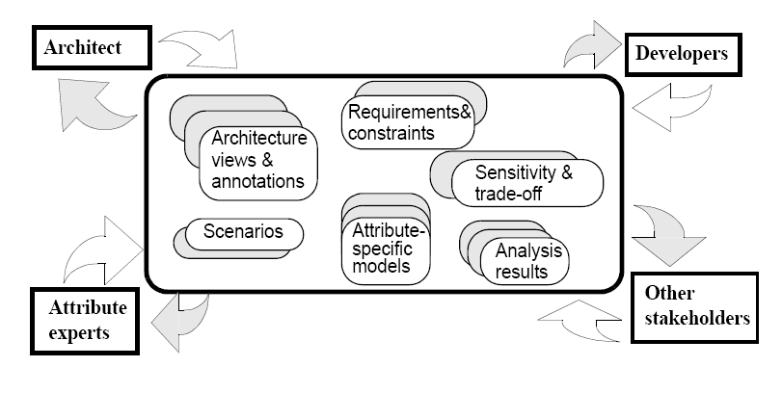
Abstract view of ATAM
Architecture Trade-off Analysis:
Software Quality Attributes and
Evaluations - Mario R. Barbacci
SEI , CMU

Slide 4
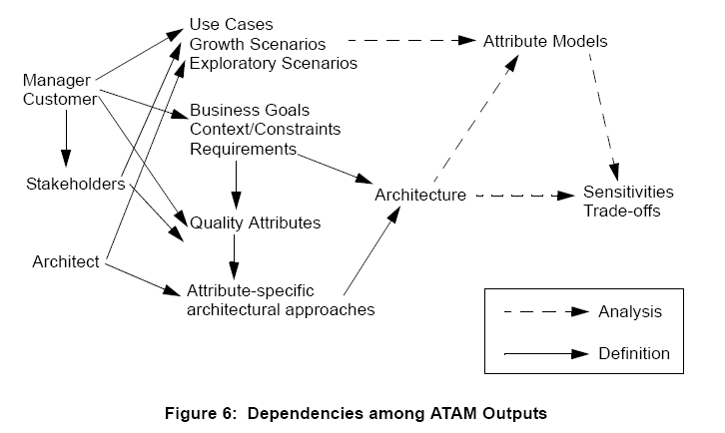
ATAM DEPENDENCIES

Slide 5
ATAM STEPS
Day1and Day2 Activities
Lead evaluator presents ATAM
Manager/customer presents overview.
Architect presents architecture.
Scenarios generated.
Mapping of them onto architecture.
Skeleton analysis made.
Day 3 Activities
Brainstorming .
Prioritizations.
Analysis.
Debriefing.

Slide 6
ATAM STEPS (contd..)
1. Present the ATAM – Lead
2. Present Business Drivers – Project Manager
3. Present Architecture – Lead Architect
4. Identify Architecture Approaches – Architect
5. Generate Quality Attributes and Utility tree
6. Analyze architectural approaches
7. Brain storming and Prioritize scenario
8. Analyze architectural approaches
9. Present results.
Material from technical report on ATAM by Kazman, Klein, Clements August 2000 SEI CMU

Slide 7
An Example Evaluvation : BCS
BCS – Battle Control System
What’s the use?
To control movement, strategy and operation of troops.
Requirements:
Provide support to a commander who can control a set of soldiers and weapons
Interface with other systems that feed command and intelligence

Slide 8
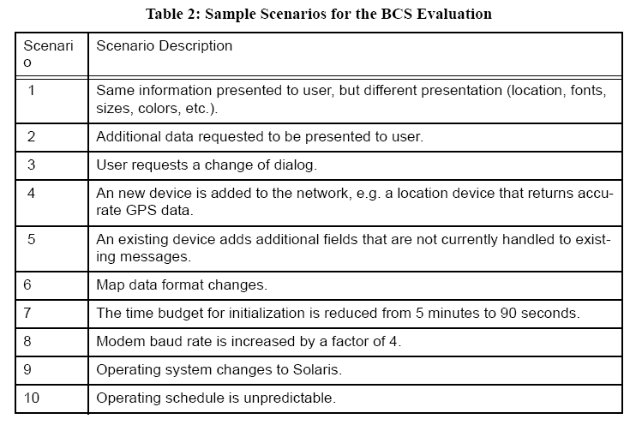
Scenarios in BCS

Slide 9
Classification of scenarios
Use cases
same information different format.
server chooses channel.
Growth scenarios
add new device.
change of dialog.
Exploratory scenarios
time budget for initialization is 5min to 90 sec.
Modem baud rate is increased by factor of 4.

Slide 10
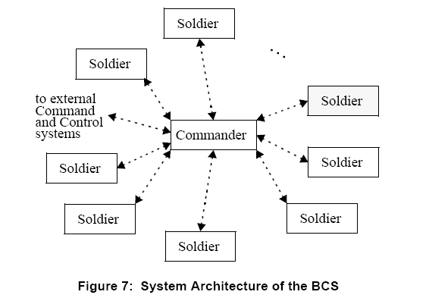
System Architecture-BCS

Slide 11
Screening questions
For what functions of the system is performance not important?
How performance is affected by scaling workload?
Q(s) = F(Qm,Qa,Qp)

Slide 12
Performance
Scenario transition from client to server and vice-versa.
Only one channel to communicate
Qp = h(n,m,CO) sensitivity points
Global trade off Identification
Backup time and availability are traded.
Qa= g(n,m)
Trade off points are Qp and Qa

Slide 13
Interesting points
Large projects->many stakeholders
-> own ideas->incomplete description.
Small projects -> many redundant views.
Extent of participation from various
stake holders.
clear understanding of system.
ARID (Architectural review for intermediate design) applied to third party components. ->not much documentation, sub systems level

Slide 14
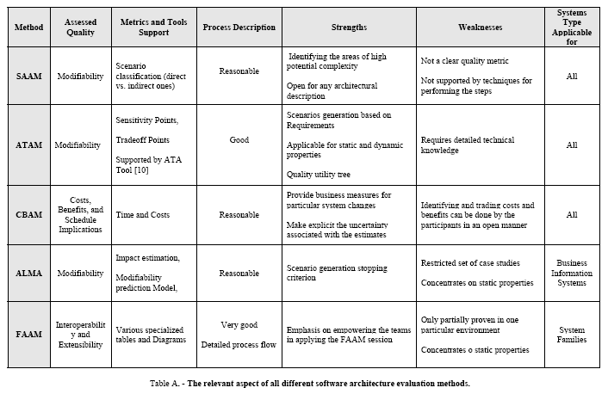
Comparison of Evaluating Methods
Table from Scenario based Software architecture evaluation and methods : an overview by Mugurel T Ionita , Dieter K Hammer, Henk Obbink

Slide 15
Conclusion
Young method.
Applied to complex Real world Architectures.
Reports into handbook for future use.

Slide 16
Conclusion(contd..)
It evaluates a system for all the “ility”s…
Reliability
Scalability
Modifiability
Functionality
Variability
Subsetability.

Slide 17
Questions ?

